Slide 1
Crime count forecasting and arrest prediction
By- Guided by- prof. Sowmiya Raksha NayaK
Mahesh gond (151080005)
Sandesh Nagrale (151080006)
Shrirang pinjarkar (151080008)
Vasu mhashakhetri (151080010)

Slide 2
Introduction
Crime is one of the most predominant and alarming aspects in our society and its prevention is a vital task as it is threatening public safety and disrupting the economy.
Crime forecasting is the latest technology that can be used to forecast future crimes, most vulnerable locations and decide prevention efforts.

Slide 3
Motivation
Because of increasing rate of crimes, law enforcement agencies are continuing to demand advanced GIS and new data mining approaches to improve crime analytics and for better development of their communities.
The crime rates can be significantly reduced by the real-time crime forecasting which are helpful in saving lives that is the most valuable thing.
Proper analysis of previous crime data helps in predicting the crimes and thus supports in reducing the crime rate.
These factors help in identifying patterns and determine the model which will be used to predict future criminal count and arrests.

Slide 4
Aim
The aim of this study is to develop a method to handle large dataset and develop a model that can predict crimes arrests and forecast crime counts.
Risk at a location changes over time. So, we need to take care of selecting model which will be adaptive to those changing environments.

Slide 5
Literature Review
Paper :- Detecting and Mapping Crime Hot Spots Based on Improved Attribute Oriented Induce Clustering
The original data include crime events such as event time, event class, event spatial information and event object.
A taxonomy for the event object is created as per place, time, type of case.
Algorithm:
No. of events > threshold, save this events as hotspots directly
After one generalization if the event on the attribute > threshold then keep on generalizing the attributes until no. of events on the attributes < threshold
Then attribute with the greatest same value is selected.
to avoid generalizing excessively, generalization of all the attributes must be cancelled once a hot spot is produced.

Slide 6
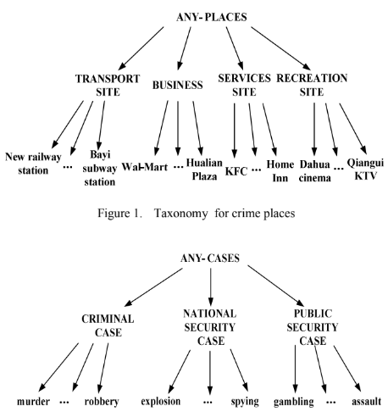
Crime place hot spots: in the results of the test, there are a lot of events concentrating on {RAILWAY STATION, FRAUD, ANY-DAY-OF-WEEK, ANY- DAY-OF-YEAR}, {SUBWAY STATION, THEFT, WORKDAY, ANY-DAY-OF-YEAR}, {SERVICES SITE, THEFT, WEEKEND, HOLIDAYS} and so on.
The relationship between transport site and theft cases, services site and theft cases, railway station and fraud cases are clear that these site related are the places hot spots. So the police should increase the deployment in these places.

Slide 7
Paper:- Feature Engineering for Crime Hotspot Detection
Feature engineering is the process of transforming raw data into features that better
represent the underlying problem to machine learning predictive models, resulting in improved model accuracy on unseen data.
An Urban Feature is an individual measurable property of the built (or static) environment of an urban area. It describe different aspects of the urban space and can be numeric or binary in nature.
Ex: Dead-End Density, School in Cell, Length Major Roads.
Spatio-Temporal Features (STF) which are rather dynamic, their measurements change over time in dependence of the criminal activities.
Ex: Odds per Area, Police Type, Road Types.
For clustering : K- Means
For prediction: Random Forest Classifier

Slide 8
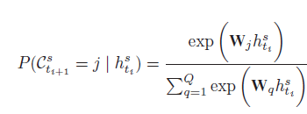
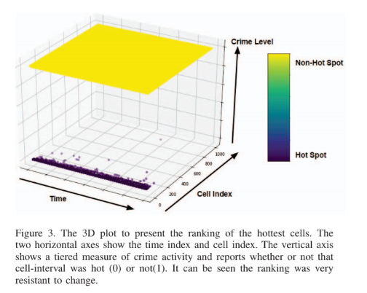
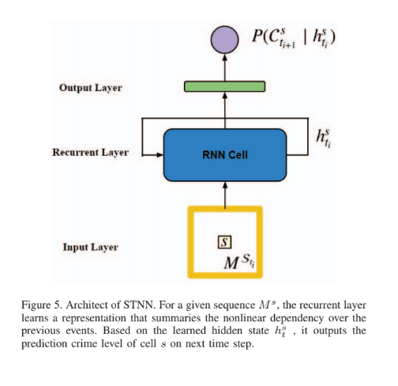
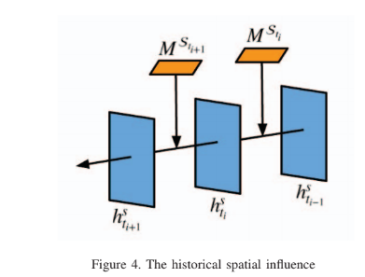
Paper:- Crime Hot Spot Forecasting:
A Recurrent Model with Spatial and Temporal Information
Hotspot Mobility
Clustering : K-Means
Prediction : Spatio-Temporal Neural Network
The 3D plot to represent the ranking of the hottest cells. The vertical axis cell-interval was hot (0) or not (1). It can be seen the ranking was very resistant to change
Architecture of STNN
The historic spatial influence

Slide 9
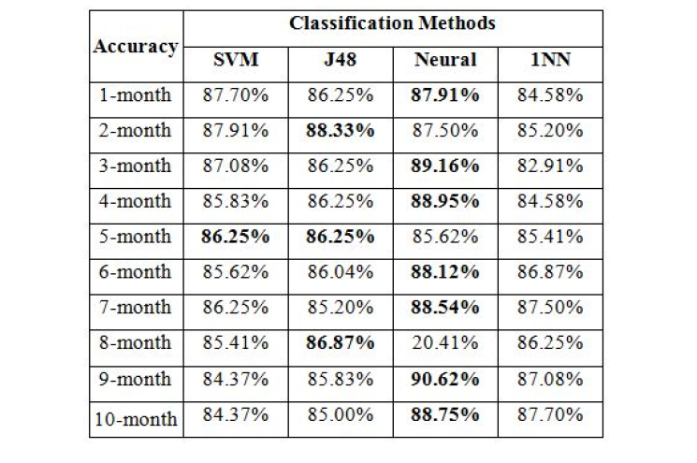
Paper:- Crime Forecasting Using Data Mining Techniques
Forecasting residential burglary over space and time
Data Grid : Arrest, Commercial Burglary, Foreclosure, Motor Vehicle Larceny, Residential Burglary, and Street Robbery
If the attribute set of category counts maps to a grid cell with at least one residential burglary,
that set is labeled a “hotspot”.
This paper is basically focused on two features
Leveraging Temporal Knowledge
Maximizing Spatial Knowledge
Prediction Algorithm : One Nearest Neighbor (1NN) ,
Decision Tree (J48) , Support Vector Machine ,
Neural Network with 2-layer network

Slide 10
Paper:- Crime Prediction and Forecasting in Tamilnadu using Clustering Approaches
Uses KNN for first data retrieving and classification
Prediction of crimes is done using various clustering approaches like K-Means, Agglomerative and DBSCAN
Google Map for visualization(GMAPI )
Advantage :-
provides best approach for clustering
Uses peculiar attributes for clustering
Disadvantages :-
Don’t give exact probability for that particular crime
More computation time for each cluster

Slide 11
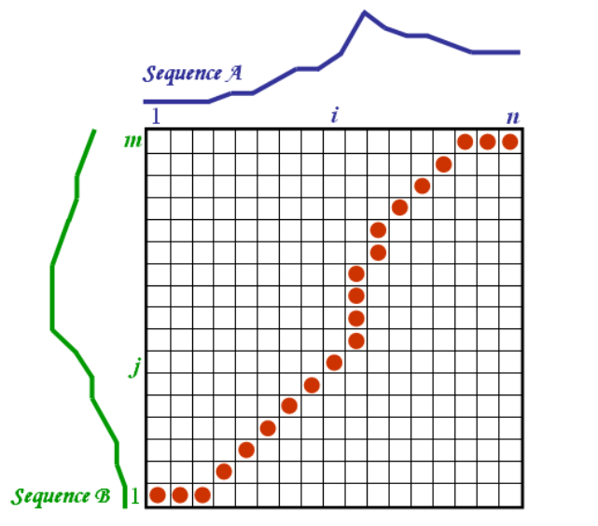

Paper:- Multivariate Time series
Drawbacks for traditional time series
high dimensionality
weightage for each type
2 types of time series
Whole
subsequence
Uses multivariate time series clustering technique based
on dynamic time wrapping (DTW)
Distance formula for DTW
dc(i, j) = d(x_{i}, y_{j})+min{dc(i−1, j−1), dc(i−1, j), dc(i, j−1)
Parametric Minkowski model

Slide 12
Procedure :-
Multivariate time series data as input→ Choose weight matrix →Compute distance matrix D→ Find a wrapping path → Find DTW→Apply hierarchical clustering → Predict crime trends
Advantage :-
Useful clustering technique as considers past time data
Useful Where the dimensions do not have equal weightages.
Disadvantage :-
Don’t give exact location based prediction
Computation for each time will be higher

Slide 13
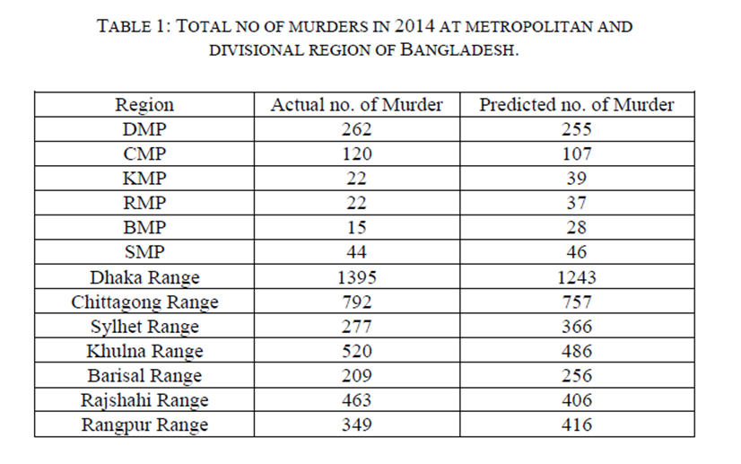
Paper:- Using Linear Regression to Forecast Future Trends in
Crime of Bangladesh
In this paper, linear regression model is used to forecast future crime trends of Bangladesh.
The real dataset of crime is collected from the website of Bangladesh police.
Then the linear regression model is trained on this dataset.
After training the model, crime forecasting is done for dacoit, robbery, murder, women & child repression, kidnapping, burglary, theft and others for different region of Bangladesh
Result shows predicted number of crimes in different regions
The model used only predicts the number of crimes
that are going to happen and does not provide
any information regarding precise location and time.

Slide 14

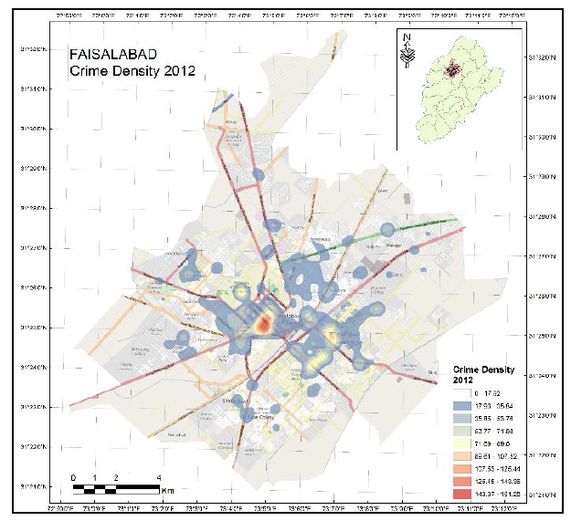
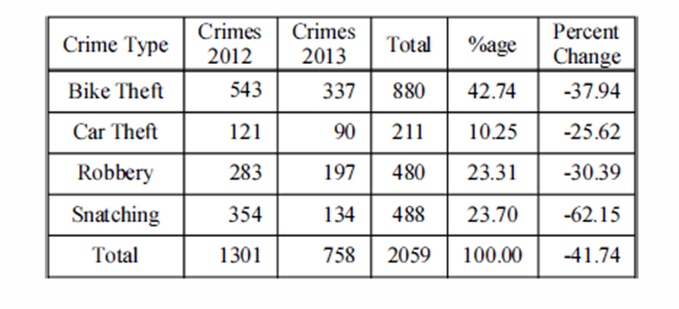
Paper:- Spatio-temporal Analysis of the Street Crime Hotspots in
Faisalabad City of Pakistan
The crime reports of 2012 were geocoded and the crime maps were prepared in ArcGIS 10.
Kernel density estimation was used for detecting the crime hotspot in the city.
The strategic crime analysis was done in a series of meetings with police department
The Compstat model with some modifications was followed.
The comparative analysis of the crime events in 2012 and 2013 shows that there was a shift in street crime hotspots.
Only for the analysis based on available data and not for making future
prediction

Slide 15
Proposed Model
Dataset :
Chicago crime dataset available on (https://data.cityofchicago.org/Public-Safety/Crimes-2001-to-present/ijzp-q8t2)
Updated every week
60 million rows
The proposed model can be divided into three modules :-
Data pre-processing
Arrest Prediction
Count Forecasting

Slide 16
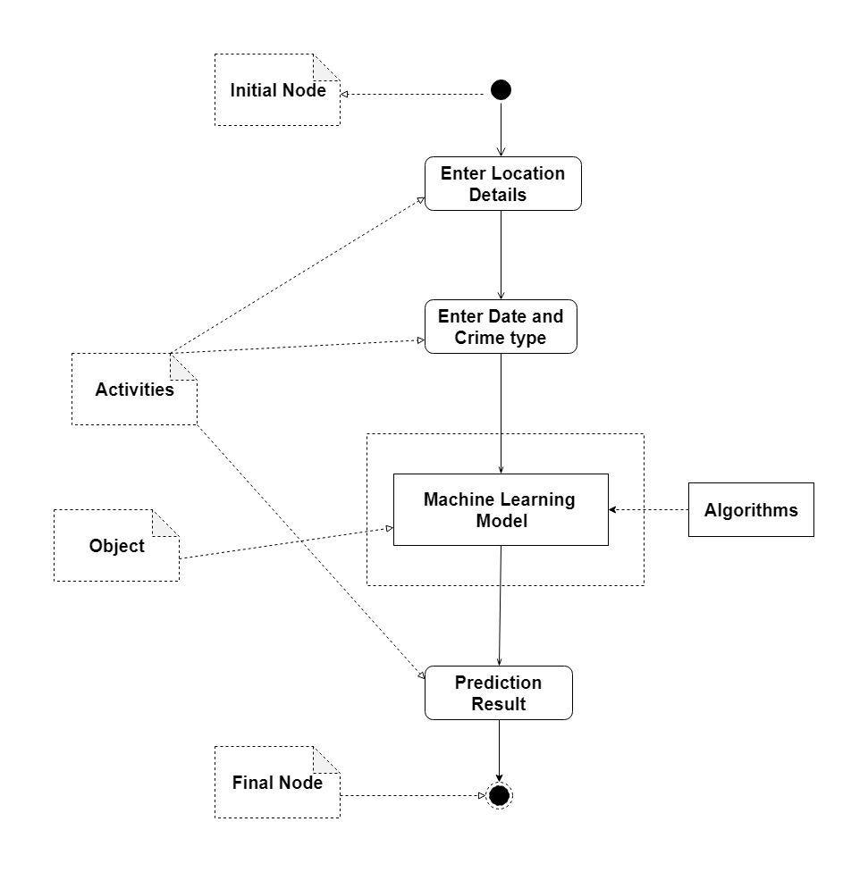
Flow Diagram

Slide 17
Data Pre-processing for arrest prediction
Missing values
Deleting rows
Feature extraction
Deleting unwanted columns
PCA

Slide 18
Data Pre-processing for count Forecasting
Missing values
Deleting rows
Feature extraction
New count column
Date formatting
Beat grouping
Indexing of new count column

Slide 19
Apply Predictive Model:-
Linear Regression : accuracy 80.7834%
Bernoulli Naïve Bayes : accuracy 76.0478%
Random Forest : accuracy 87.5435%

Slide 20
Linear Regression:-
Input
Memory and time computation
PCA
Trained with 20% split and 30 randomness
output
If > 0.5 arrest==true
else arrest==false
High accuracy
Rounding off

Slide 21
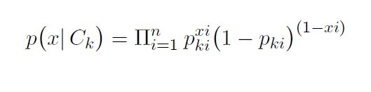
Bernoulli's Naïve Bayes:-
Input
Probability Based
Why ? Binary data
output
High accuracy
Less computation and predicting exact output makes it better

Slide 22
Random Forest:-
Input
Multiple decision Trees merge them for stable and better result
Range of Obb_error 50 to 100
n_estimators and accuracy curve
n_estimators and n_jobs =90 and -1
Accuracy = 87%

Slide 23
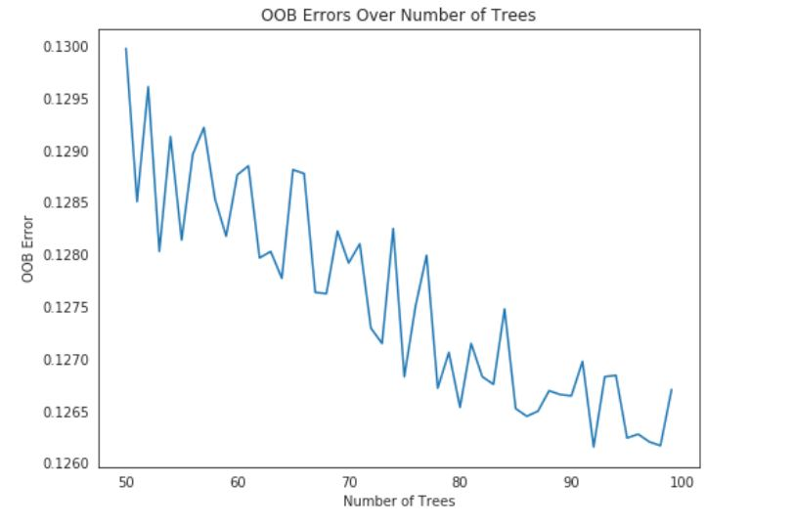
Random Forest(cont) :-

Slide 24
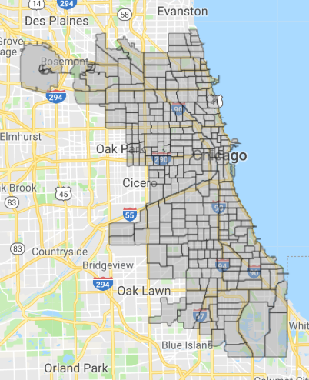
Crime Count Forecasting
Predict the number of crimes happening in an area on a particular day.
Specially here we have used the Beat area. A beat is the smallest police geographic area.
Chicago city has numerous small areas under each police
station
Time series forecasting based on :
ARIMA Model
LSTM neural networks

Slide 25
Time series forecasting using ARIMA
What is ARIMA ?
ARIMA is an acronym that stands for AutoRegressive Integrated Moving Average.
An ARIMA model is a class of statistical machine learning models for analyzing and forecasting time series data.
AR: Autoregression. A model that uses the dependent relationship between an observation and some number of lagged observations.
I: Integrated. The use of differencing of raw observations .
MA: Moving Average. A model that uses the dependency between an observation and a residual error from a moving average model applied to lagged observations.

Slide 26
Each of these components are explicitly specified in the model as a parameter.
ARIMA(p,d,q)
P = Periods to lag. P helps adjust the line that is being fitted to forecast the series.
D = In an ARIMA model we transform a time series into stationary one(series without trend or seasonality) using differencing. D refers to the number of differencing transformations required by the time series to get stationary.
Stationary time series is when the mean and variance are constant over time.
Q = This variable denotes the lag of the error component, where error component is a part of the time series not explained by trend or seasonality

Slide 27
Split the data between train and test data. Train set has 66% of the total observation and train has 44% observations.
We use the train set again to fit an ARIMA(5,2,0) model.
The parameters need to be selected which best fit the model on our time series dataset.
Rolling Forecast
re-creating the ARIMA model after each new observation is received.
We manually keep track of all observations in a list called history that is seeded with the training data and to which new observations are appended each iteration.

Slide 28
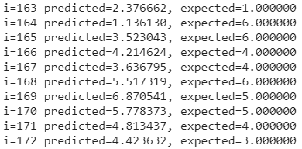
Running the model prints the prediction and expected value each iteration.
We calculated a final mean squared error score (MSE)= 11.476

Slide 29
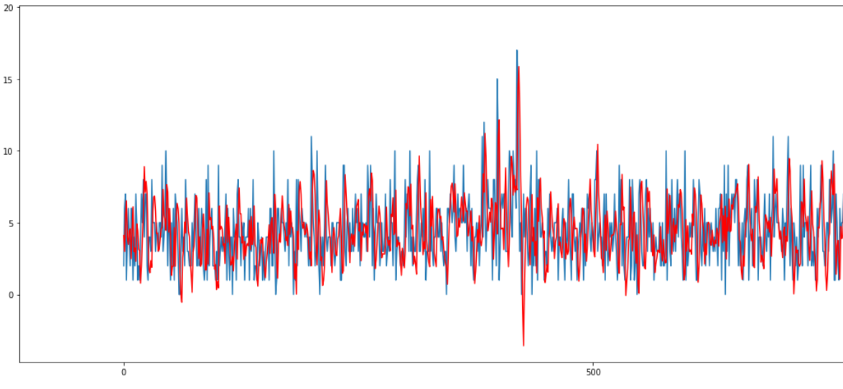
A line plot is created showing the expected values (blue) compared to the rolling forecast predictions (red).

Slide 30
Proposed Model
LSTM Model for Multi-Step Time Series Forecasting of Crime Prediction
Multi-Step Time Series Data
Strategy used for multi-step time series
Data Processing for LSTM
LSTM Neural Network
Training Neural Network
Forecasting Crime Count
Inverse Transformation of Forecasted Crime Count

Slide 31
Strategies for making multi-step forecasts
Direct Multi-step Forecast Strategy prediction(t+1) = model1(obs(t-1), obs(t-2), ..., obs(t-n)) prediction(t+2) = model2(obs(t-2), obs(t-3), ..., obs(t-n))
Recursive Multi-step Forecast Strategy prediction(t+1) = model(obs(t-1), obs(t-2), ..., obs(t-n)) prediction(t+2) = model(prediction(t+1), obs(t-1), ..., obs(t-n))
Direct-Recursive Hybrid Multi-step Forecast Strategies prediction(t+1) = model1(obs(t-1), obs(t-2), ..., obs(t-n)) prediction(t+2) = model2(prediction(t+1), obs(t-1), ..., obs(t-n))
Multiple Output Forecast Strategy (Strategy Used) prediction(t+1), prediction(t+2) = model(obs(t-1), obs(t-2), ..., obs(t-n))
Most commonly used strategies for making multi-step forecasts

Slide 32
Data Processing
Stationary. The data shows an increasing trend that must be removed by differencing.
Scale. The scale of the data must be reduced to values between -1 and 1, the activation function of the LSTM units.
Date | Beat 111
01/01/2001 | 5
02/01/2001 | 7
03/01/2001 | 8
04/01/2001 | 11
Difference
2
1
3

Slide 33
Supervised Learning Problem
Transform the data from a series into a supervised learning problem
Make a next two days forecast based on previous crime counts for the last 2 years
Historical observations (t-1, t-2, … t-n)
forecast t, t+1
n_lags = 365*2 = 730 (Last 730 observations)
n_seq = 2 (Forecasting 2 observation)
n_test = 10 (No. of test observation)

Slide 34
LSTM Neural Network
Long Short-Term Memory (LSTM) networks
An extension for recurrent neural networks
Remember their inputs over a long period of time
In an LSTM, three gates: input, forget and output gate
Input Layer : LSTM layer (30 neurons, dropout = 0.2, stateful = True)
Hidden Layer : LSTM layer unit with (60 neurons, stateful = True)
Output layer : Dense layer with linear activation and 2 output values
Epochs = 50
Batch size = 1

Slide 35
